Slide 1

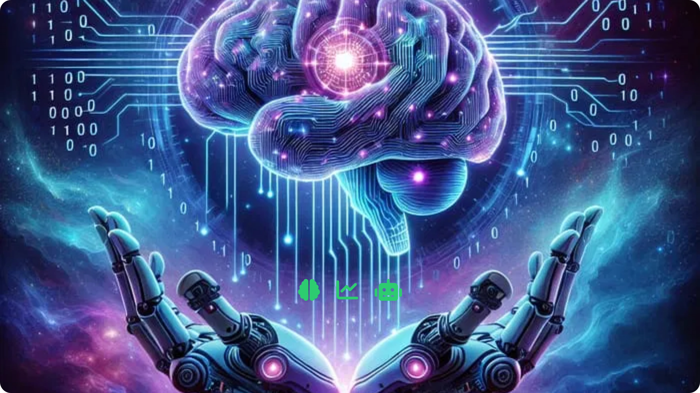



Data Science, AI & Machine Learning for Beginners
Introduction to the fundamentals

Slide 2







Table of Contents
Key Concepts of Data Science, Machine Learning, Artificial Intelligence
Difference between DS vs ML vs AI
Importance of Data Science and Machine Learning
Roles and Responsibilities of Data Science
Skills Required for Data Science
2

Slide 3
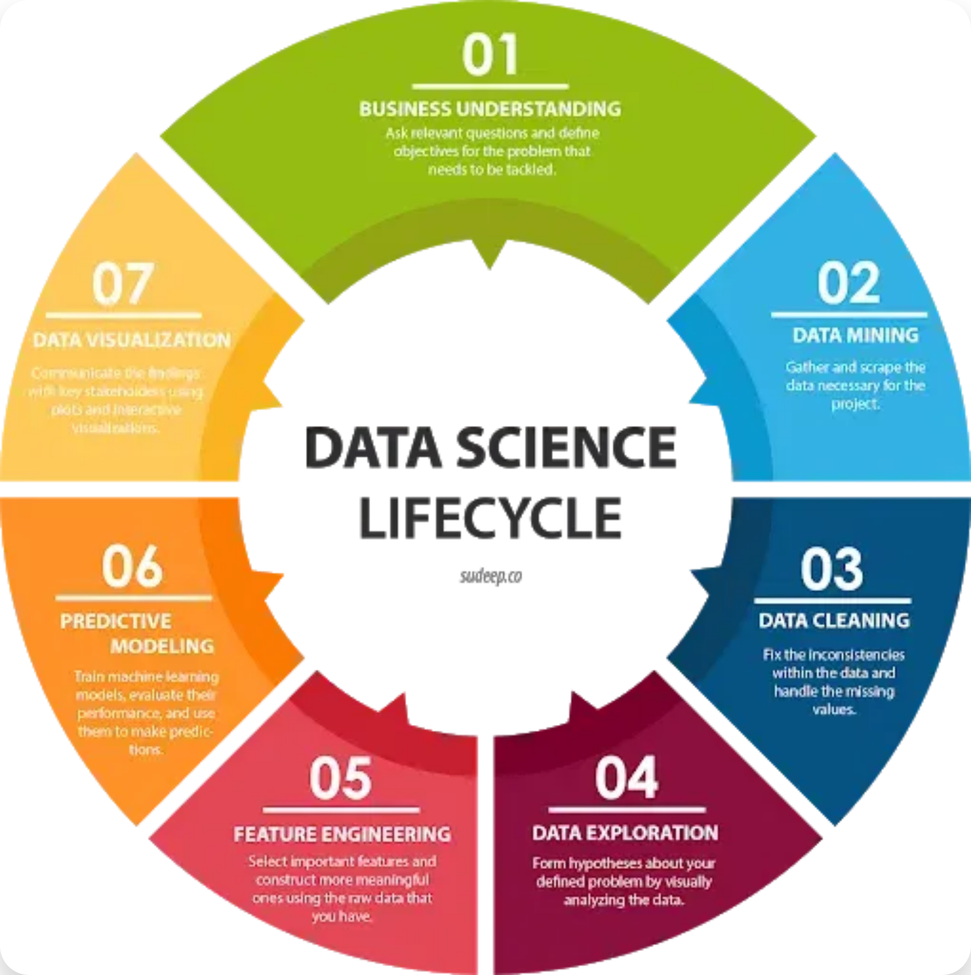



What is Data Science?
Data science is the process of
extracting
meaningful insights
and knowledge from data.
It involves collecting, organizing, and analyzing
large amounts of data to understand patterns,
make predictions, or inform decisions.
Data scientists use various techniques from
statistics, mathematics, and computer science to
interpret complex data and solve
real-world
problems
.
3

Slide 4
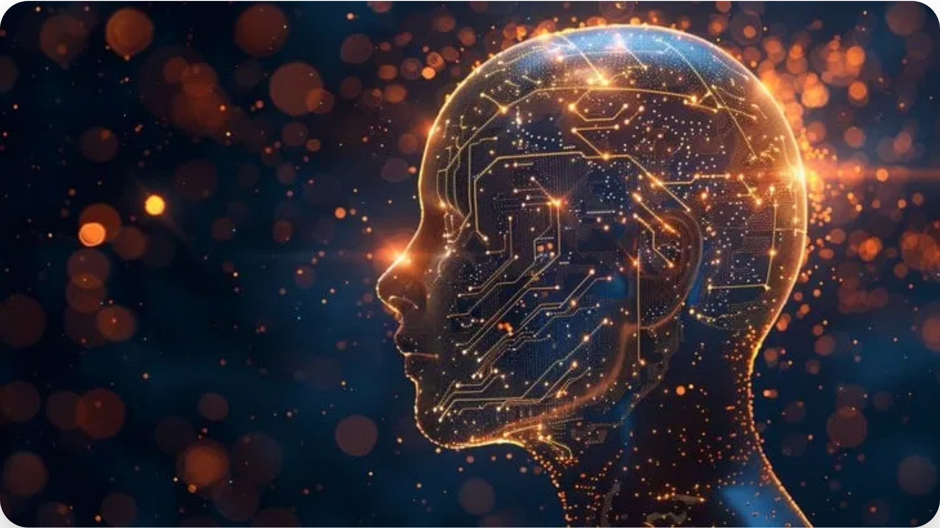



What is Artificial Intelligence?
Artificial Intelligence (AI) is the field of technology
focused on creating machines and software that
can perform tasks that usually require
human
intelligence
.
This includes things like
understanding
language
, recognizing images, solving problems,
and making decisions.
4

Slide 5


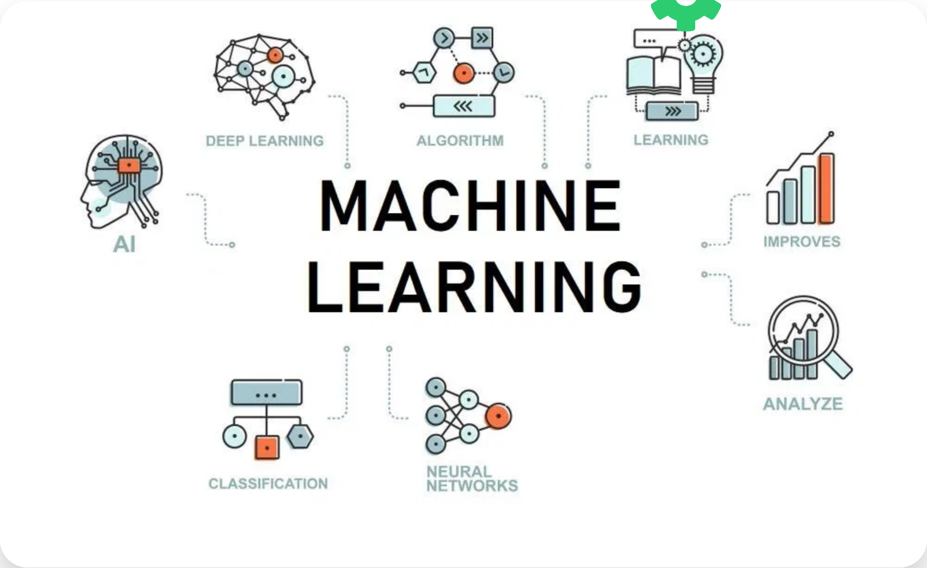

What is Machine Learning?
Machine learning enables computers to
learn
from data
and make decisions or predictions
without being explicitly programmed for each
specific task.
Instead of following hard-coded instructions, a
machine learning model
identifies patterns
in
the data and uses those patterns to make
predictions or decisions.
5

Slide 6





Difference Between DS, AI & ML
Data Science
Artificial Intelligence
Machine Learning
DS is the field that
focused on creating programs that learn from data without being explicitly programmed for each task.
or makes decisions with the help of past and present data.
predicts
AI is the broad field of creating
smart systems
ML is a
subset of AI
that can perform tasks requiring human-like intelligence.
DS processes data (both structured and unstructured) to understand trends and patterns and provide actionable information.
AI combines large amounts of data with intelligent algorithms to help computers learn and make decisions on their own.
ML uses data to build models that improve their performance over time based on experience.
Involves data operations such as sourcing, cleaning, and processing.
Uses logic, decision trees, and can include machine learning techniques.
Uses statistical methods to identify patterns and make predictions.
6

Slide 7









Importance of Data Science and Machine Learning
Data Science
Machine Learning
Informed Decision-Making
Automation
Improving Efficiency
Enhanced Accuracy
Predictive Analytics
Personalization
Data-Driven Innovation
Improving Customer Experience
7

Slide 8












Roles and Responsibilities of Data Scientists
Define objectives and business problems
Collect and gather relevant data
Process and clean the data
Integrate and store data
Perform exploratory analysis
Choose models and algorithms
Apply data science techniques
Measure and improve results
Present results to stakeholders
Make adjustments based on feedback
8

Slide 9








Skills Required for Data Science
Programming Languages
Statistics & Probability
Python, R, SQL, Java, Scala for data manipulation and analysis
Hypothesis testing, distributions, regression analysis, statistical modeling
Database Management
Machine Learning
SQL, NoSQL databases, data warehousing, ETL processes
Supervised/unsupervised learning, neural networks, deep learning
Data Visualization
Interpersonal Skills
Tableau, Power BI, matplotlib, D3.js for effective data presentation
Communication, storytelling, teamwork, business understanding
9

Slide 10






Getting Started - Next Steps
Learn the Fundamentals
Start with Python programming, statistics, and data manipulation libraries like Pandas and NumPy.
Practice with Projects
Apply your knowledge to real datasets through guided projects and Kaggle competitions.
Join Communities
Connect with other learners through forums, meetups, and online communities like Stack Overflow and GitHub.
Continuous Learning
Stay updated with the latest trends, tools, and techniques through online courses and workshops.
10

